Slide 1
STROKE PREDICTION
Prepared By:
Samir Alam

Slide 2
Content
Data Introduction
Data Pre-Processing
Data Training
Model Deployment

Slide 3
Data Introduction
For Pre-processing and data training we have imported the following labraies.
import numpy as np
Numpy:- NumPy is the fundamental package for scientific computing in Python.
import pandas as pd
pandas is a Python package providing fast, flexible, and expressive data structures
from sklearn.model_selection import train_test_split, cross_val_score
Train_Test_Split is used for splitting the data.
import matplotlib.pyplot as plt
We have used matplotlib.pyplot for visualization.
from sklearn.preprocessing import LabelEncoder
we use Label encoder for normalizing labels.
from sklearn.preprocessing import StandardScaler
we use standard scaler for removing the mean and scales each variable to unit variance.
from sklearn.linear_model import LogisticRegression
we have used logistic regression to predict a binary outcome.

Slide 4
from sklearn.neighbors import KNeighborsClassifier
K Nearest Neighbor algorithm falls under the Supervised Learning category and is used for classification (most commonly) and regression.
from sklearn.tree import DecisionTreeClassifier
A decision tree is a very specific type of probability tree that enables you to make a decision about some kind of process.
from sklearn.ensemble import RandomForestClassifier
Random forests creates decision trees on randomly selected data samples, gets prediction from each tree and selects the best solution by means of voting.
from sklearn.naive_bayes import BernoulliNB
We have used Bernoulli NB for features with binary or Boolean values like TRUE/FALSE or 0/1.
from sklearn.svm import SVC
Support Vector Machine (SVM) is a supervised machine learning algorithm capable of performing classification, regression and even outlier detection.
import pickle
We have used pickle for serializing and deserializing.

Slide 5
Now, we are explaining the data which we have imported in this code,
In this data there are 5110 rows and 12 columns.
The columns name are list below:-
Id:- This columns contains the id of patients.
Gender:- This columns contains patients is either male or female.
Hypertension:- This columns contains that either patients have hypertension or not.
Heart disease:- This columns contains that either patients have Heart disease or not.

Slide 6
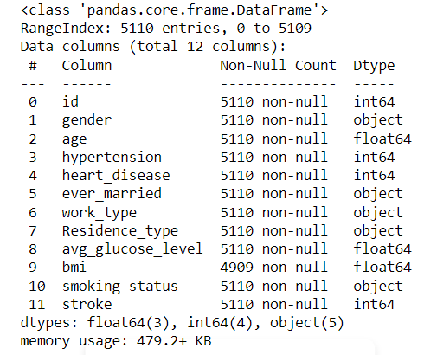
This shows that the data type of all columns and is there any null value or not in the data set.
In the above figure we can see that BMI have non-null value 4909 so, it means that BMI contains some null value i.e. 201 null values.

Slide 7
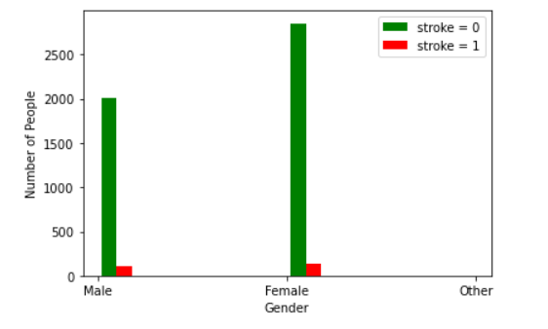
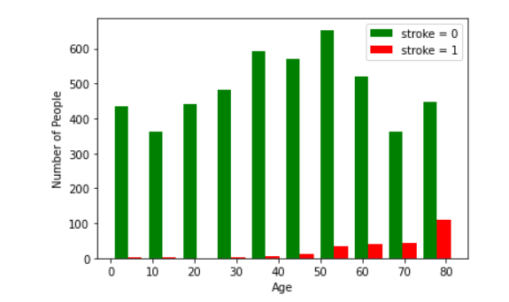
The Gender goup of female have a high probability to get stroke as we can see in the above plot diagram .
The probability of age group 80 is higher rate of stroke as given in the above figure.

Slide 8
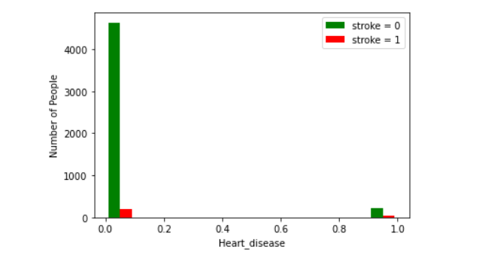
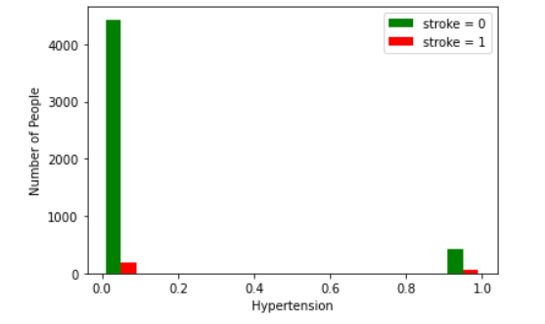
The people not having hypertension have more probability have stroke then people having hypertension as shown in above figure.
The people not having heart disease is more probability of stroke then the people having heart disease is less probability as shown in the above figure.

Slide 9
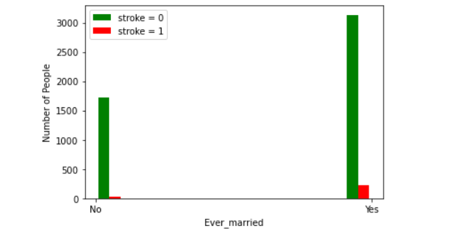
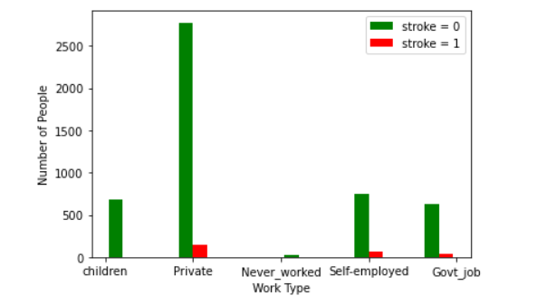
The people married is more probability of stroke then the people not married is less probability of stroke as shown in the above figure.
The people Private work type is more probability of stroke then the people other work type is less probability of stroke as shown in the above figure.

Slide 10
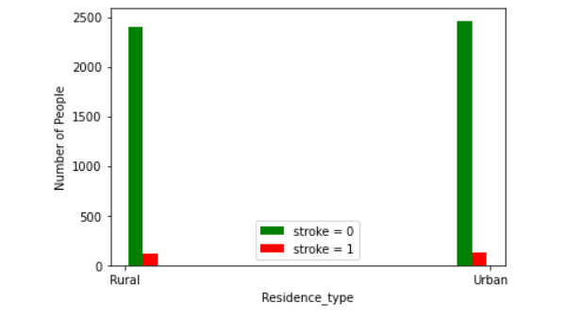
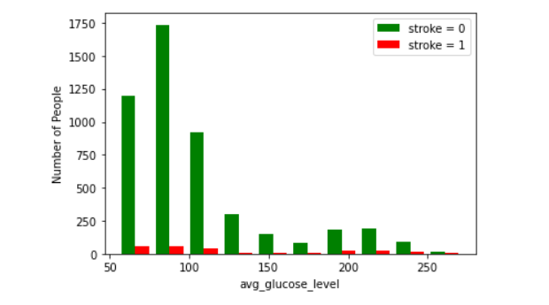
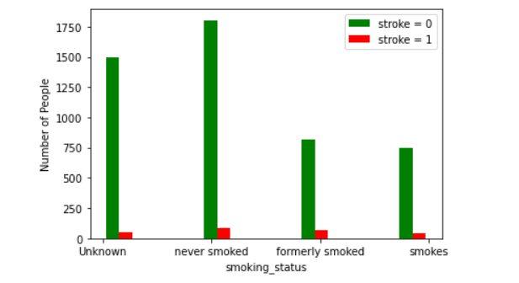
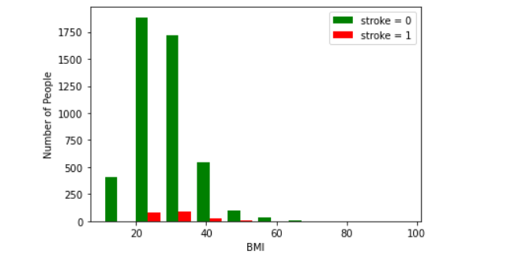
The people of urban is more probability of stroke then the people of rural is less probability of stroke as shown in the above figure.
The people from 50-100 is more probability of stroke as shown in the above figure.
The people having BMI in range 20-40 have more probability of stroke as shown in the above figure.
The people never smoked is more probability of stroke as shown in the above figure.

Slide 11
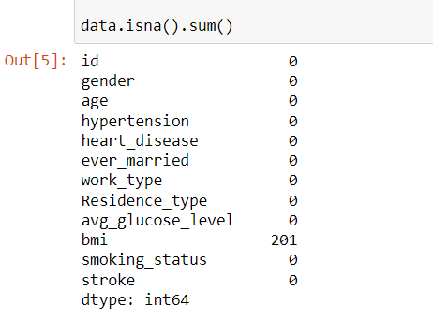
Data Preprocessing
. Here we are calculating the number of columns contain null values using isna().sum() method

Slide 12

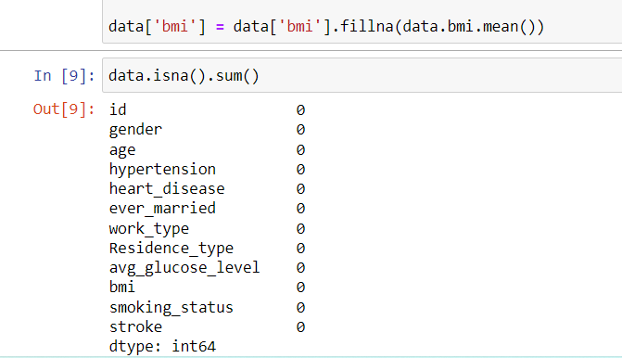
. In aur data there are missing values in bmi columns so we are using fillna method and replacing the missing values with mean values
We have dropped id column as it does not require to model.

Slide 13
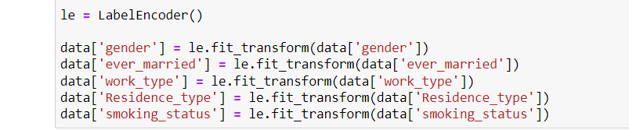
.In our data there are some values which is in categorical form so here we are using label encoder to convert our categorical values into numerical values

Slide 14
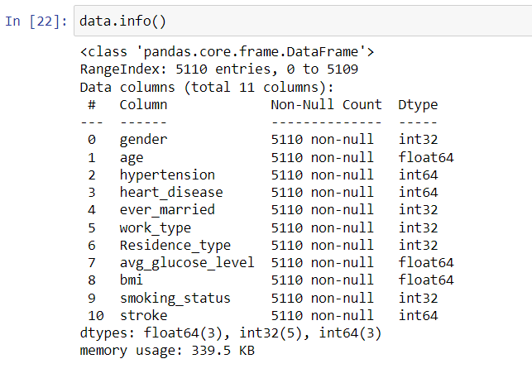
. Here we are using data.info() method to get some important information about data

Slide 15

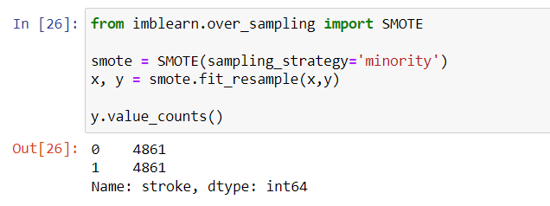
. Here we are splitting aur data into independent and dependent variables
As our dependent values are unbalanced i.e row with stroke 0 are more than the stroke value1. So, To make balance we have imported SMOTE from imblearn library and we have balanced the dataset.

Slide 16

. Here we are converting our data into training and testing data and 30% persent of our data are giving for testing and using random state =4
In our data some of the values are high and some are very low to for mapping data of each columns in same range here we are using StandarScaler() method

Slide 17
Model Used
Logistic Regression
KNeighbors Classifiers
Decision Tree Classifier
Random Forest Classifier
BernoullibNB
SVC

Slide 18
Model Used To Calculate Accuracy And Recall
Cross Value Score
The cross_val_score() function will be used to perform the evaluation, taking the dataset and cross-validation configuration and returning a list of scores calculated for each fold. The complete example is listed below.

Slide 19
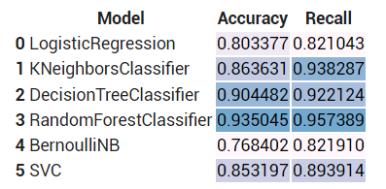
As you can see we got higher accuracy and recall value from “Random Forest Classifier”. So we have used random forest classifier.

Slide 20
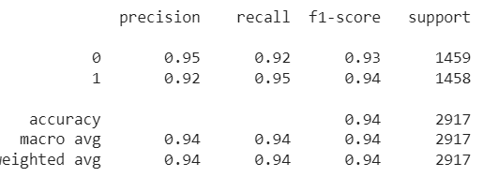
Classification Report

Slide 21
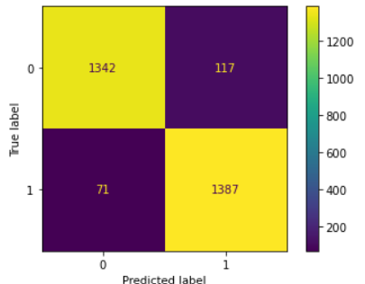
Confusion Matrix
As we can see that 1342 value are 0 and our model also predicted 0 and 117 are 0 but predicted 1.
71 are1 but our model have predicted 0 and 1387 values are 1 and model predicted them correct.

Slide 22
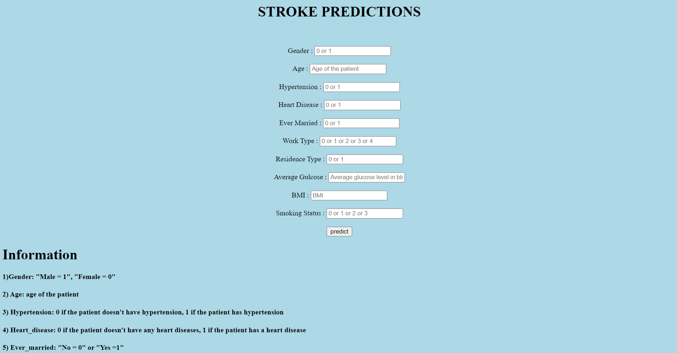
Model Deployment
We have deployed our model using Flask and HTML.

Slide 23
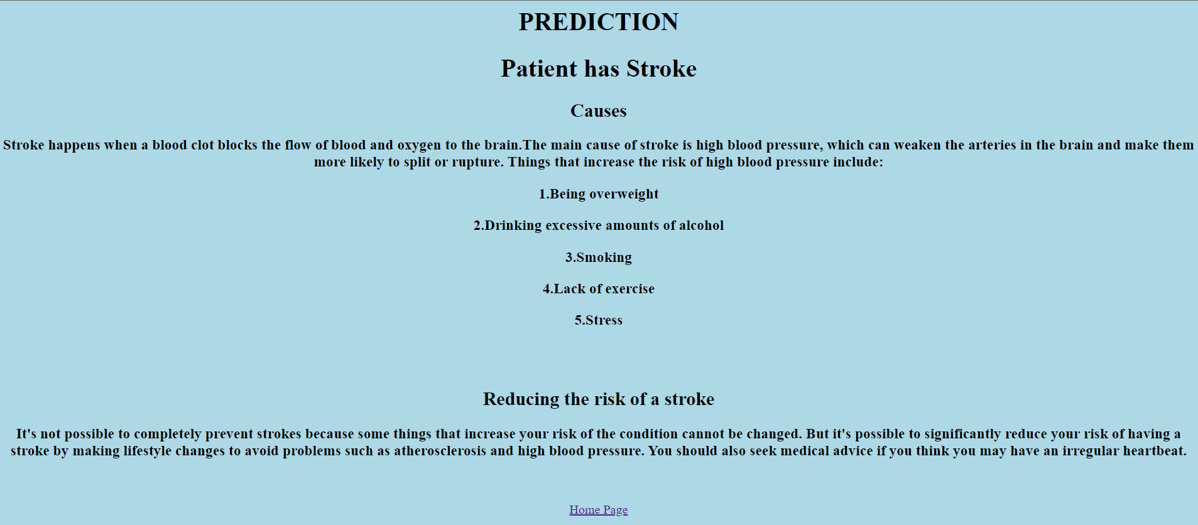

Slide 24
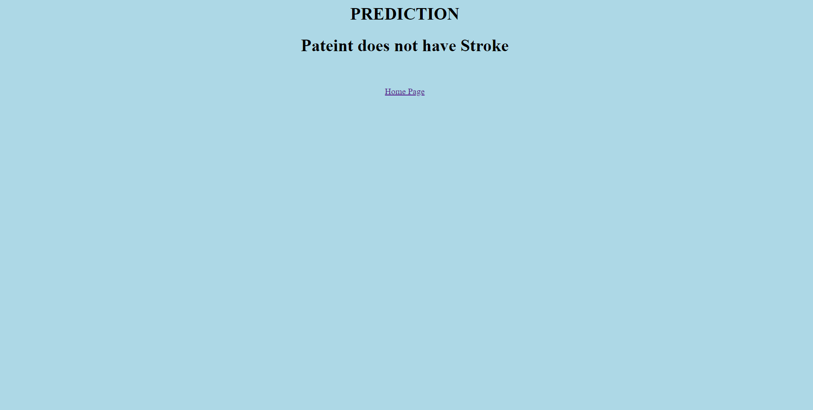

Slide 25
***THANK YOU***

